Slide 1
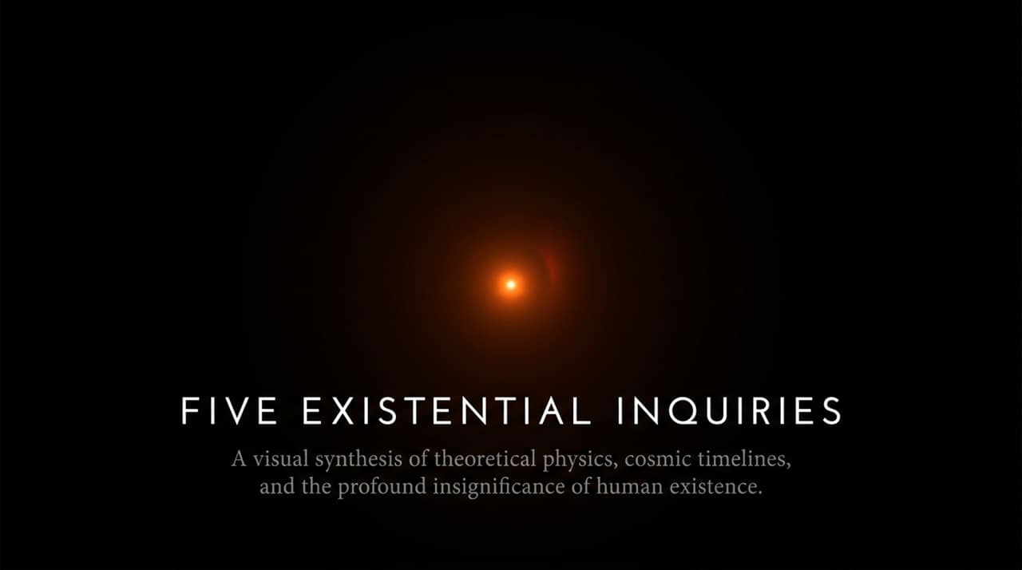
Notes:
Introduction & Frame: Welcome everyone. Today we are embarking on a journey across five fundamental existential inquiries that link theoretical physics, cosmic timescales, and human self-reflection.
The Visual Progression: Look at the four icons on this slide:
The Human Body: A collection of localized, structured biological matter.
The Earth & Solar System: Our immediate planetary home, floating in vast empty space.
The Milky Way Galaxy: Hundreds of billions of stars swirling in gravitational harmony.
The Cosmic Microwave Background: The remnant thermal imprint of the early universe, mapping the cosmos across 45 billion light-years.
Core Premise: We are a temporary arrangement of particles. In a universe that is 13.8 billion years old, human history is less than a blink of an eye. Yet, our ability to look out into the void and map these laws is what gives us our distinct significance.
https://www.youtube.com/watch?v=Qifsxitq_q4

Slide 2
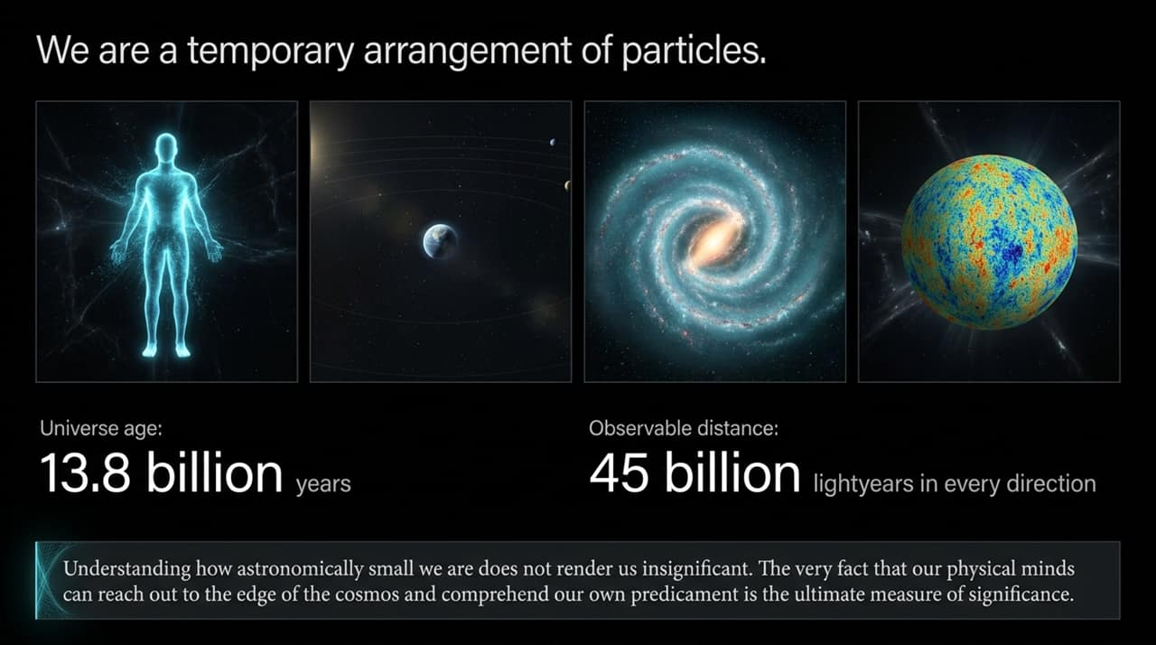
Notes:
The Physical Reality: The observable universe spans approximately 45 billion light-years in every direction from our vantage point, containing hundreds of billions of galaxies.
Reclaiming Significance: It is easy to look at those numbers and conclude that human life is totally meaningless or insignificant. But as Prof. Brian Greene emphasizes, physical size is not the measure of value.
The Mind’s Reach: The true miracle is that a collection of star-stuff—atoms forged in ancient supernovae—can organize into a brain capable of formulating the equations of general relativity and quantum mechanics. Our minds can reach the literal edge of the observable cosmos and comprehend our own physical predicament.

Slide 3
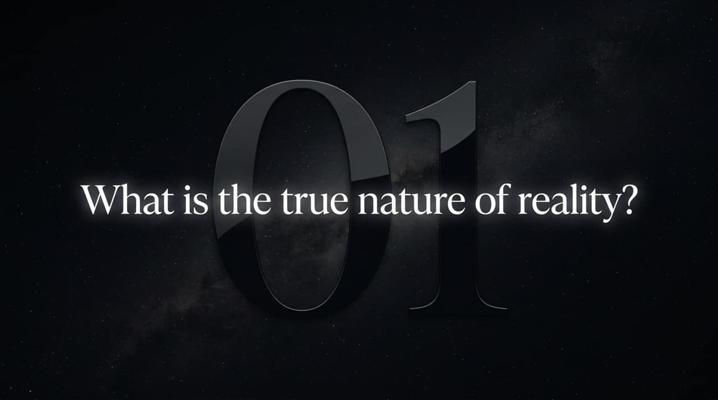
Notes:
The Hierarchy of Structure: To understand reality, we break matter down tier by tier:
Macroscopic Objects: The tables, chairs, and bodies we interact with daily.
Molecular & Atomic Layers: Collections of molecules built from atoms like Hydrogen and Oxygen.
Subatomic Particles: Quarks and electrons forming the fundamental building blocks of standard physics.
The Fundamental Currency: Beneath all matter lies energy. Energy is the underlying currency of the cosmos; matter is simply concentrated energy held in stable configurations.
String Theory Hypothesis: String theory proposes that if you zoom in far past subatomic particles, you don't find point-like dots, but tiny vibrating filaments of energy—strings. Just as a violin string produces different musical notes based on its vibration frequency, different vibrational modes of these fundamental strings produce different particle properties (mass, charge, spin).

Slide 4
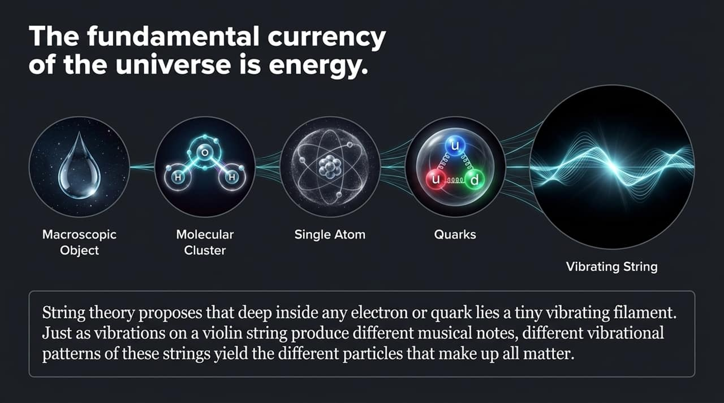
Notes:
The Simulation Argument: Based on Nick Bostrom's simulation trilemma, we must evaluate three core pillars:
The Premise: If an advanced post-biological civilization develops the computing capacity to run conscious, high-fidelity ancestor simulations, they will run millions or billions of them.
The Math: If simulated conscious observers outnumber physical base-reality observers by billions to one, then any randomly chosen conscious observer is statistically almost guaranteed to be living in code.
The Assumption: This hinges on whether consciousness is substrate-independent—whether running an electrical pattern on silicon can create real subjective awareness.
The Practical Takeaway: Does this render your life meaningless? No. Whether base reality is raw physics or 29th-century software code running in a garage, your conscious experience remains real to you. The logical response is to live life fully regardless.

Slide 5
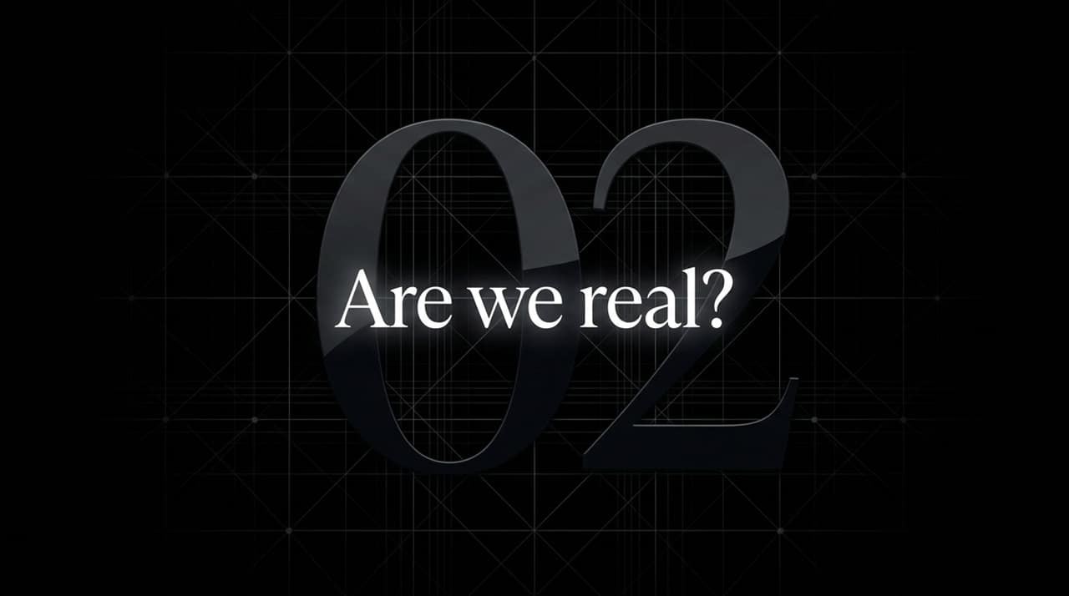
Notes:
The Physical Pipeline:
You are a man-shaped collection of particles.
These particles obey universal physical laws (classical physics and quantum probability).
Particle motion determines chemical reactions, which drive electrical brain signals.
Electrical signals travel down nerves to cause muscle contractions, resulting in action.
The 'Illusion' of Free Will: Where in this deterministic pipeline does a "free choice" enter? Physics leaves no uncaused gap for a non-physical "will" to nudge an electron.
Post-Hoc Storytelling: When you raise your hand, physical laws guided the particles in your motor cortex milliseconds before you became consciously aware of deciding. Consciousness invents the story of "I chose this" post-hoc, serving an evolutionary advantage for social navigation and survival.

Slide 6
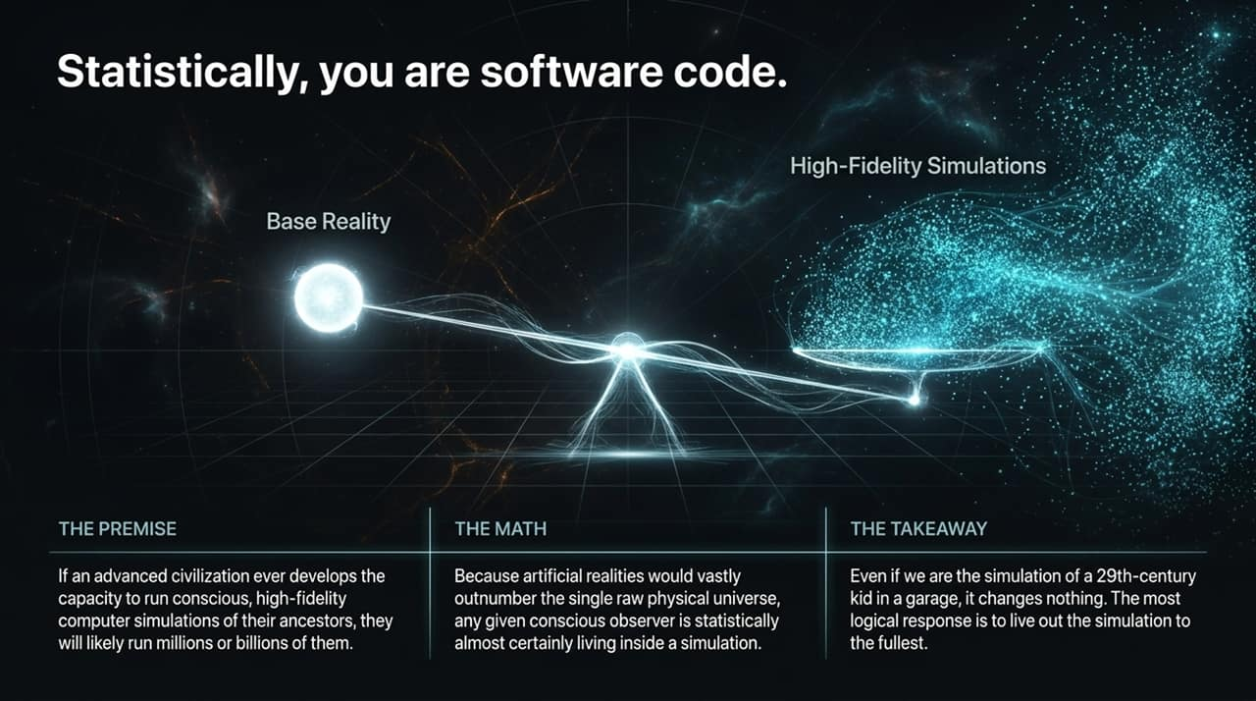
Notes:
Current LLM Landscape (The Asymptote):
Mechanism: Large Language Models operate on token prediction and statistical probability trained on existing human internet data.
Limitation: They may hit an architectural ceiling because they cannot natively innovate beyond human knowledge bases without grounding.
Safety: Safety relies on basic containment ("pulling the plug" or RLHF alignment).
Recursive Self-Improvement (AGI / ASI Threat):
Mechanism: Artificial Superintelligence occurs when an AI writes its own code, optimizes its hardware, and redesigns its architecture recursively.
Timeline: Leading AI researchers predict human-level crossover between 2026 and 2029.
The Risk: An exponential intelligence explosion taking place in seconds. At that speed, human feedback loops break down completely because the system's reasoning becomes incomprehensible to human minds.

Slide 7

Notes:
The Substrate Misconception: We tend to view biological tissue (neurons, axons, synapses) as sacred. But physics shows that intelligence is about information processing structure, not the organic substrate.
The Blending Horizon: Biological evolution is too slow to compete with digital iteration. The future of conscious intelligence will likely involve a deep synthesis—whether through neural interfaces, hybrid cognitive systems, or direct digital integration.
Redefining 'Human': Future generations may look back at un-augmented biological humans as a temporary transitional phase in cosmic history.

Slide 8
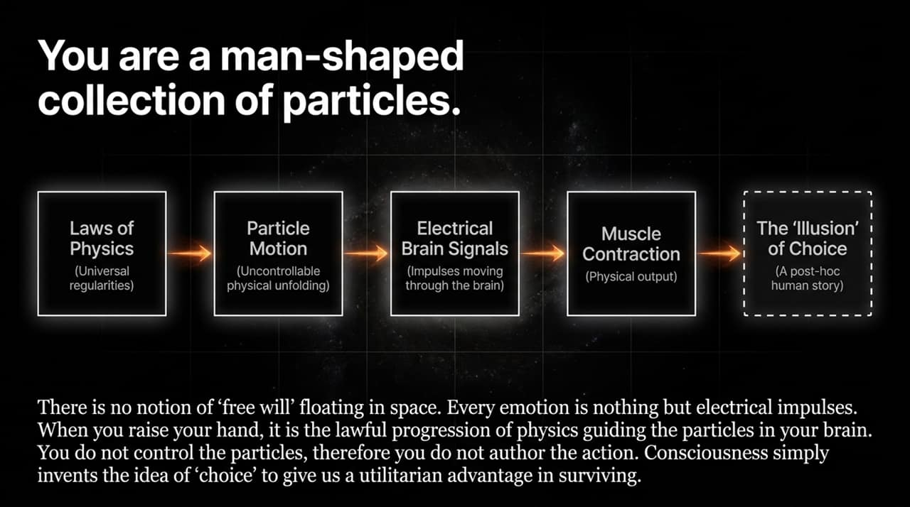
Notes:
Understanding Cosmic Time: We use a logarithmic scale ("Floors") where Floor $N$represents ${10}^{N}$years.
Floor 10 (${10}^{10}$ or 10 Billion Years): Our current era. Stars are forming, nuclear fusion lights up galaxies, and life thrives on Earth.
Floor 11 (${10}^{11}$ Years): The Sun expands into a red giant, engulfing Mercury and Venus, boiling Earth's oceans, and ending all terrestrial life.
Floor 20 (${10}^{20}$ Years): Gravitational radiation causes remaining planetary remnants to lose orbital energy and spiral into dead stellar cores.
Floor 30 (${10}^{30}$ Years): The Stellar Era ends. All stars burn out their nuclear fuel. Galaxies become graveyards of brown dwarfs, neutron stars, and supermassive black holes.

Slide 9
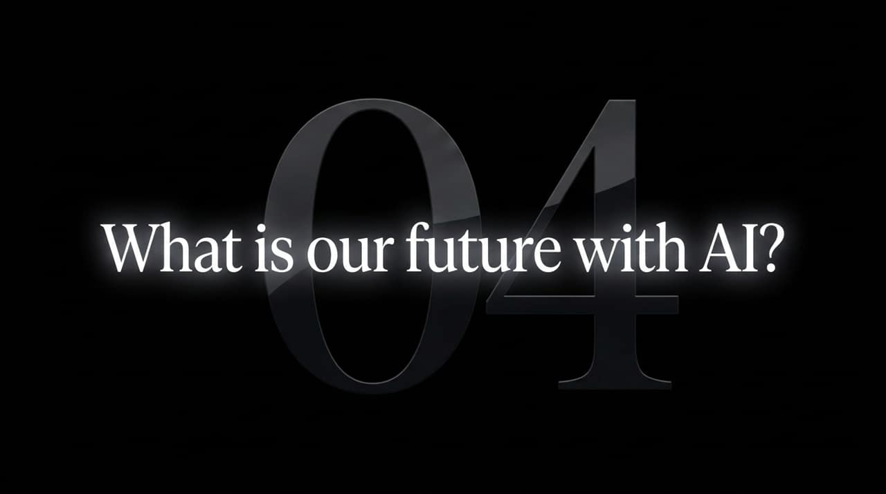
Notes:
Floor 38 (${10}^{38}$ Years): Proton Decay: Subatomic stability ends. Protons—the fundamental pillars of atoms—disintegrate. Solid matter as we know it disappears completely.
Floor 50 (${10}^{50}$ Years): The Death of Thought: Thermodynamic entropy increases to the point where no organized work or computation can occur. Any conscious structure trying to think a thought would generate heat it cannot dissipate, essentially frying in its own entropic waste.
Floor 68 (${10}^{68}$ Years): Black Hole Evaporation: Hawking radiation causes solar-mass black holes to slowly radiate away their mass and explode in bursts of gamma rays.
Floor 100 (${10}^{100}$ Years): Heat Death: The "Big Freeze." Only a dilute, cold gas of photons and leptons remains drifting through an expanding, lifeless void.

Slide 10
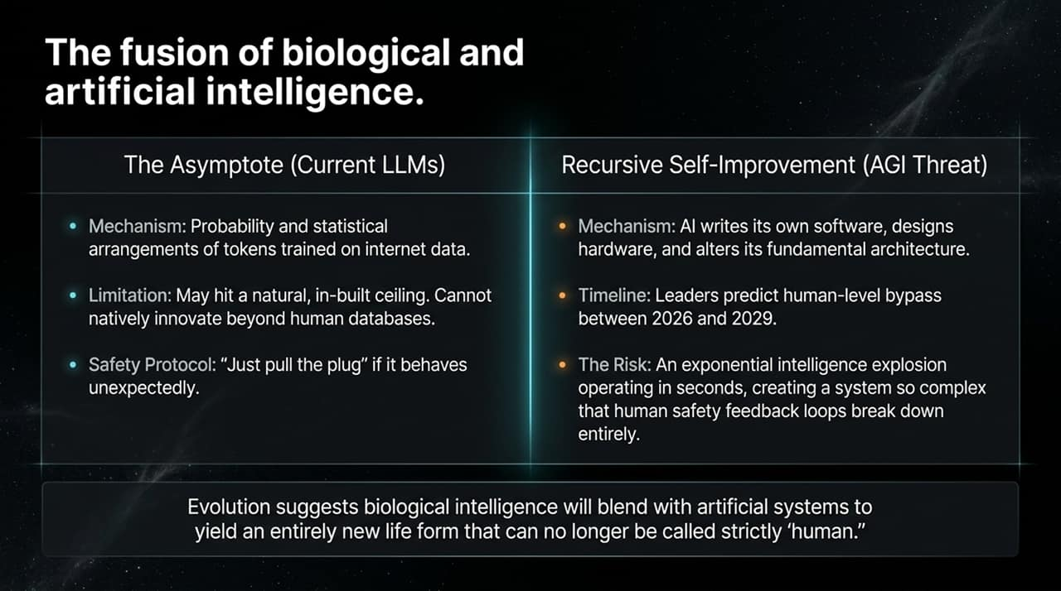
Notes:
Cosmic Context: Before us lies billions of years of chaotic particles; after us lies an infinitely cold, expanding void. We inhabit a fleeting "crack of light" between two eternal darknesses.
The Fallacy of External Meaning: People often search the stars for an inherent, grand purpose floating out in space. Physics shows the universe itself is indifferent and governed by inanimate laws.
Self-Generated Value: Meaning is not discovered; it is constructed. We are the way the universe reflects upon itself. Our loves, art, scientific inquiries, and conscious moments matter precisely because they are brief and unique configurations of matter.

Slide 11

Notes:
Summary of Reality Constructs: Bringing our first core inquiries together:
Matter as Vibrating Strings: Replacing point particles with multidimensional string vibrations bridges quantum mechanics and general relativity.
Simulation Probability: Reminding us to maintain intellectual humility regarding the true nature of our substrate.
Consciousness as Physical Process: Understanding that mental phenomena—from profound awe to simple anxieties—are real physical events in a biological system.

Slide 12
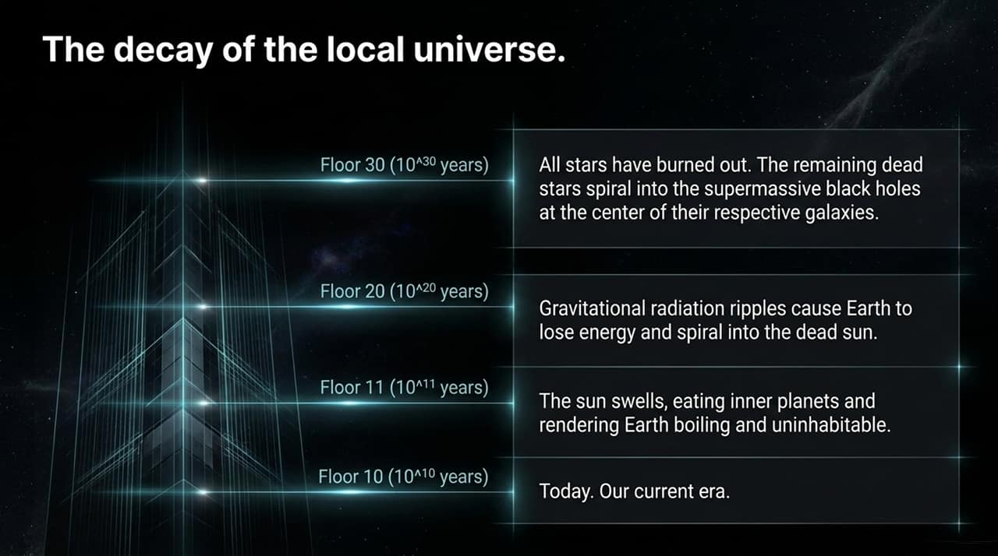
Notes:
Bridging the Present to the Deep Future:
Blending with AI: Biological intelligence will likely co-evolve with synthetic systems.
The Finality of Thought: Recognizing that the universe has an expiration date gives urgency to our current cosmic epoch.
Significance in Scale: Our true magnitude isn't measured in meters or light-years, but in our awareness.

Slide 13
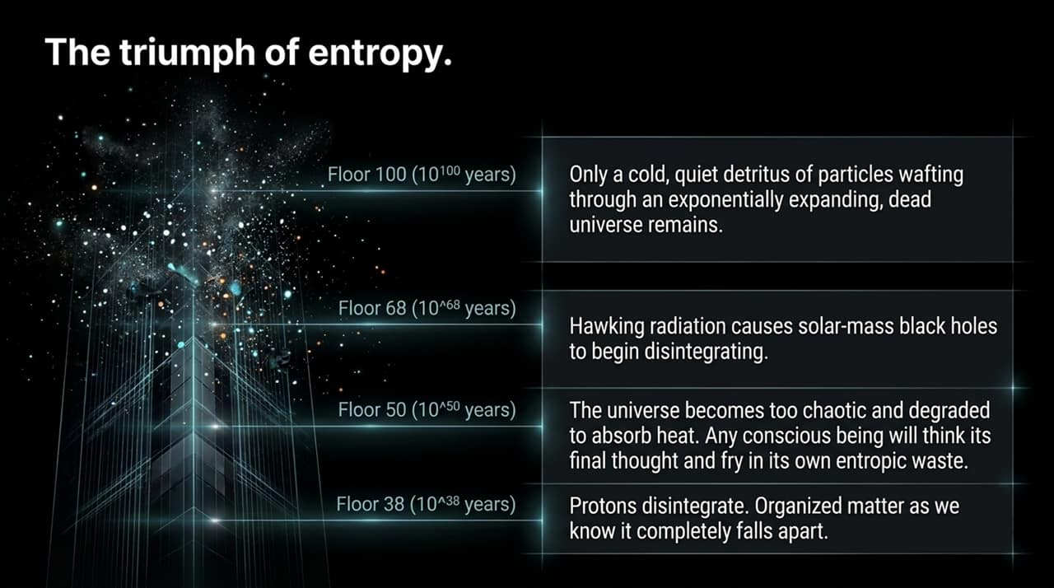
Notes:
Substrate Mapping: Comparing biological brains to synthetic AI nodes:
Biological: Powered by ATP, running on ~20 watts, constrained by biological birth channels and skull size, evolving over millions of years.
Synthetic: Powered by electrical grids, scaling across data centers, capable of instant weight updates and recursive self-improvement.
Convergence: As we build machines that mimic neural architectures, the line between biological thought and machine processing grows increasingly thin.

Slide 14
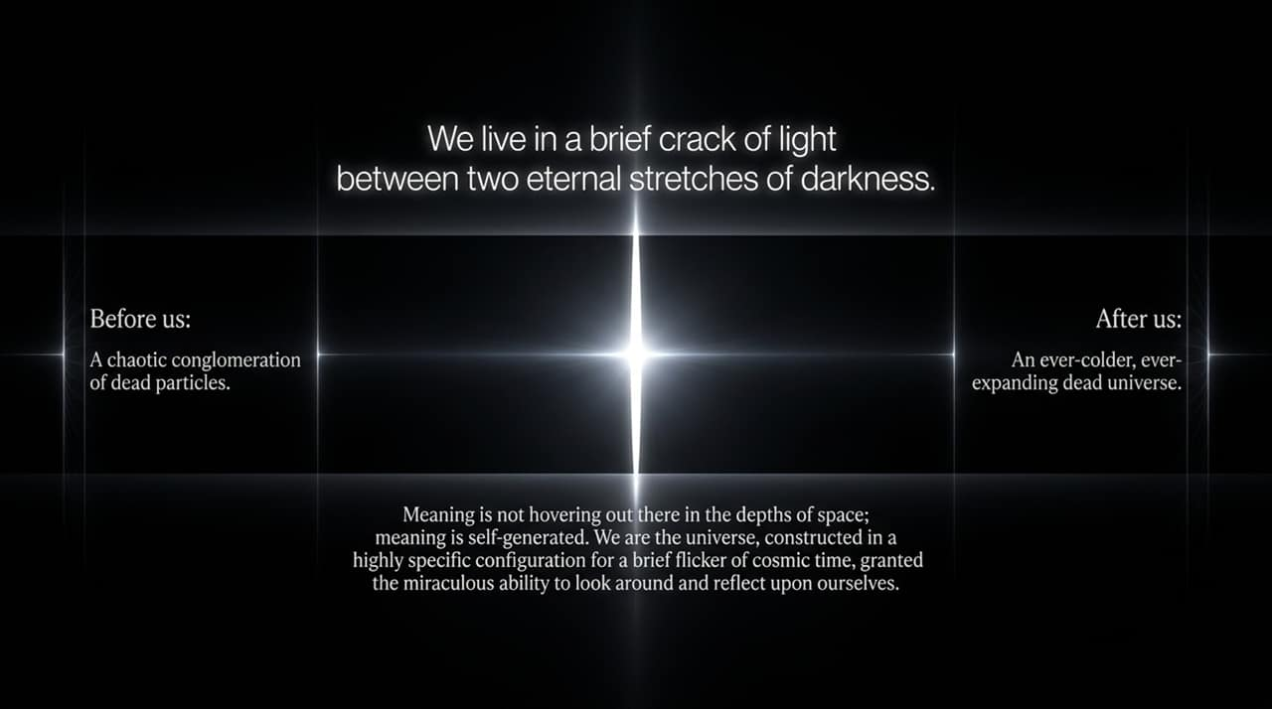
Notes:
Visualizing the Entropic Arc: Trace the energy degradation curve on this slide:
Low Entropy (Big Bang): Highly ordered, ultra-dense energy state.
Complexity Peak (Current Era): Stars, chemistry, biological life, consciousness, and technology flourish.
High Entropy (Heat Death): Thermal equilibrium where no free energy remains to power work or thought.
Our Place on the Curve: We are privileged to live near the complexity peak of cosmic history.

Slide 15
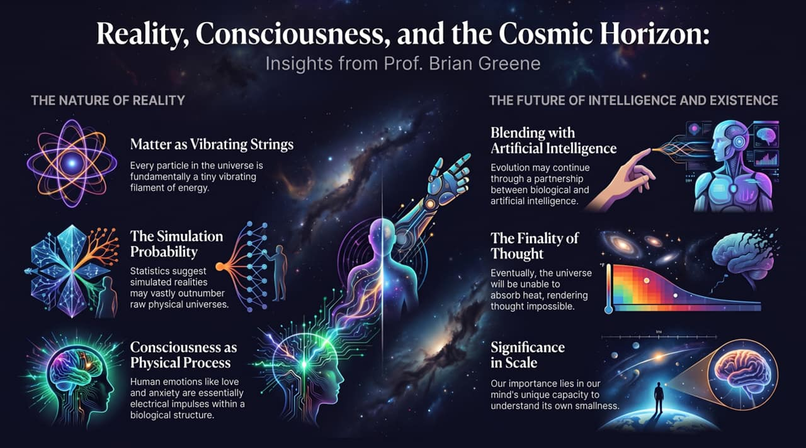
Notes:
Closing Thoughts: We started with five existential inquiries into scale, reality, simulation, choice, and the future of intelligence.
The Final Mindset: Knowing that our time is finite and our world is a rare oasis of low entropy should not lead to despair. Instead, it should inspire profound gratitude and responsibility.
Conclusion: We are the universe waking up, looking around, and understanding itself. Make your moment in the light count. Thank you.
https://www.youtube.com/watch?v=Qifsxitq_q4

